Slide 1
Support vector machine analysis of NTM infection
Garrett Meek

Slide 2

Methods
Sputum from 17 patients with cystic fibrosis
Median of 10 samples per patient
Analyzed sputum microbial composition to identify features unique to nontuberculosis mycobacterial (NTM) infection
Median collection period prior to NTM therapy (when necessary) was 1.3 years
www.cff.org

Slide 3
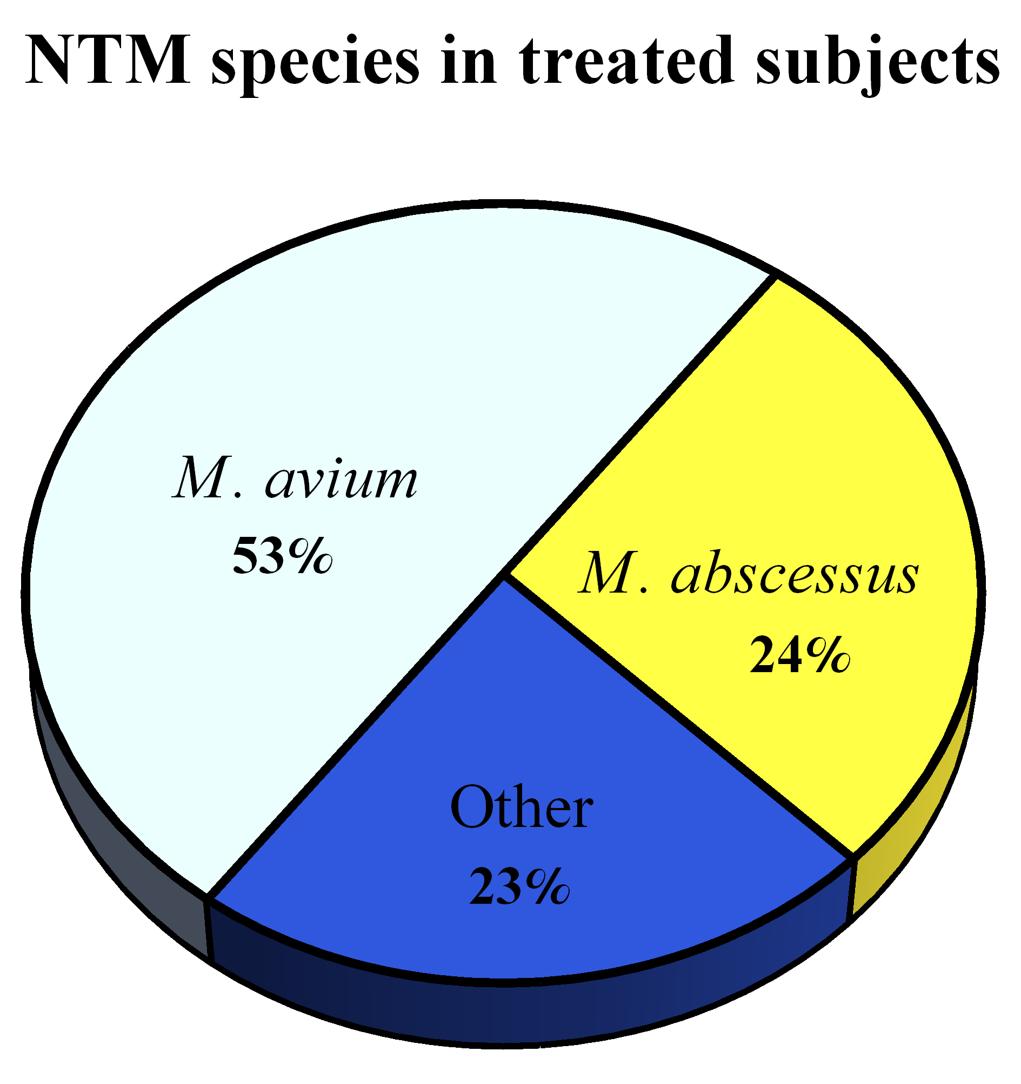
NTM infection in cohort

Slide 4
Question we want to answer:
What microbial/clinical features distinguish these subjects in the year before NTM therapy?
Microbial
Shannon diversity
Evenness
Anaerobe abundance
Clinical
FEV1
Age
Gender

Slide 5
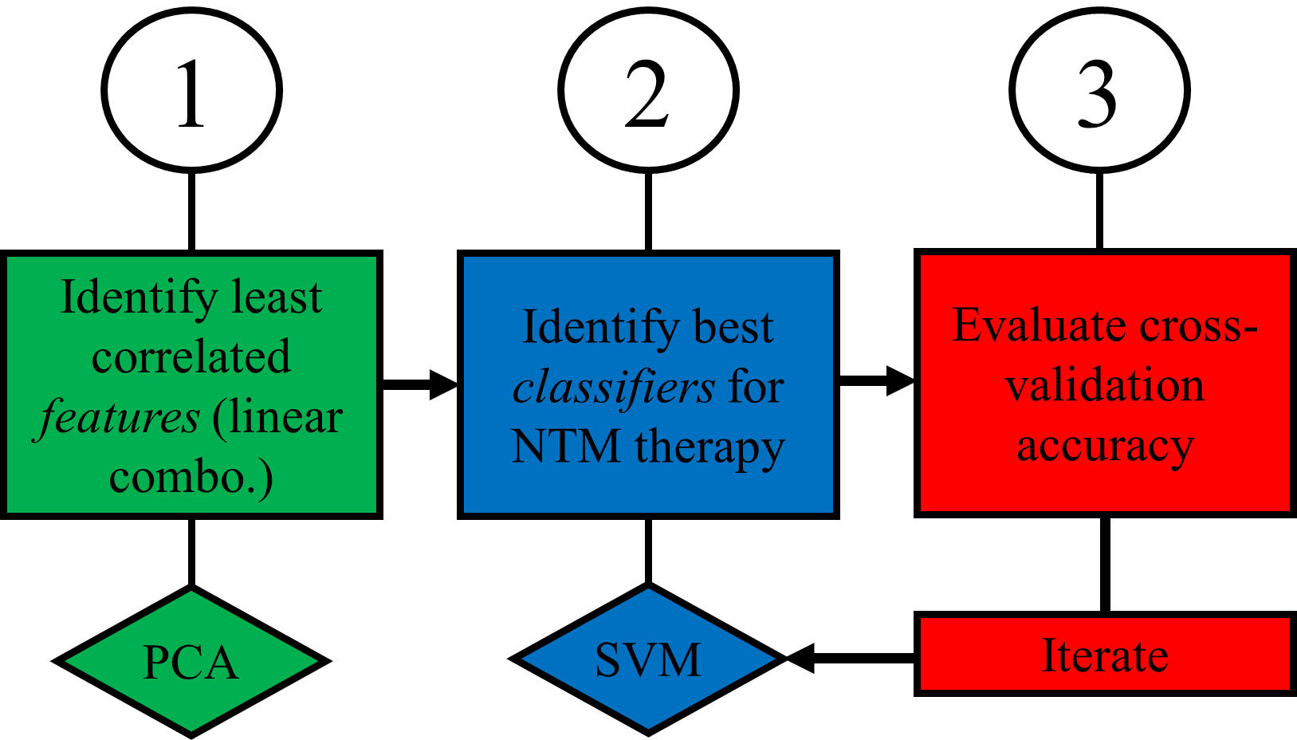
Methods
Feature: Measurable microbial/clinical (or linear combo. of) characteristics for a study subject
Microbial
Shannon diversity
Evenness
Anaerobe abundance
Clinical
FEV1
Age
Gender

Slide 6
Methods
Classifier: feature that distinguishes members of different classes
Microbial
Shannon diversity
Evenness
Anaerobe abundance
Clinical
FEV1
Age
Gender

Slide 7
Methods
Cross-validation
Microbial
Shannon diversity
Evenness
Anaerobe abundance
Clinical
FEV1
Age
Gender

Slide 8
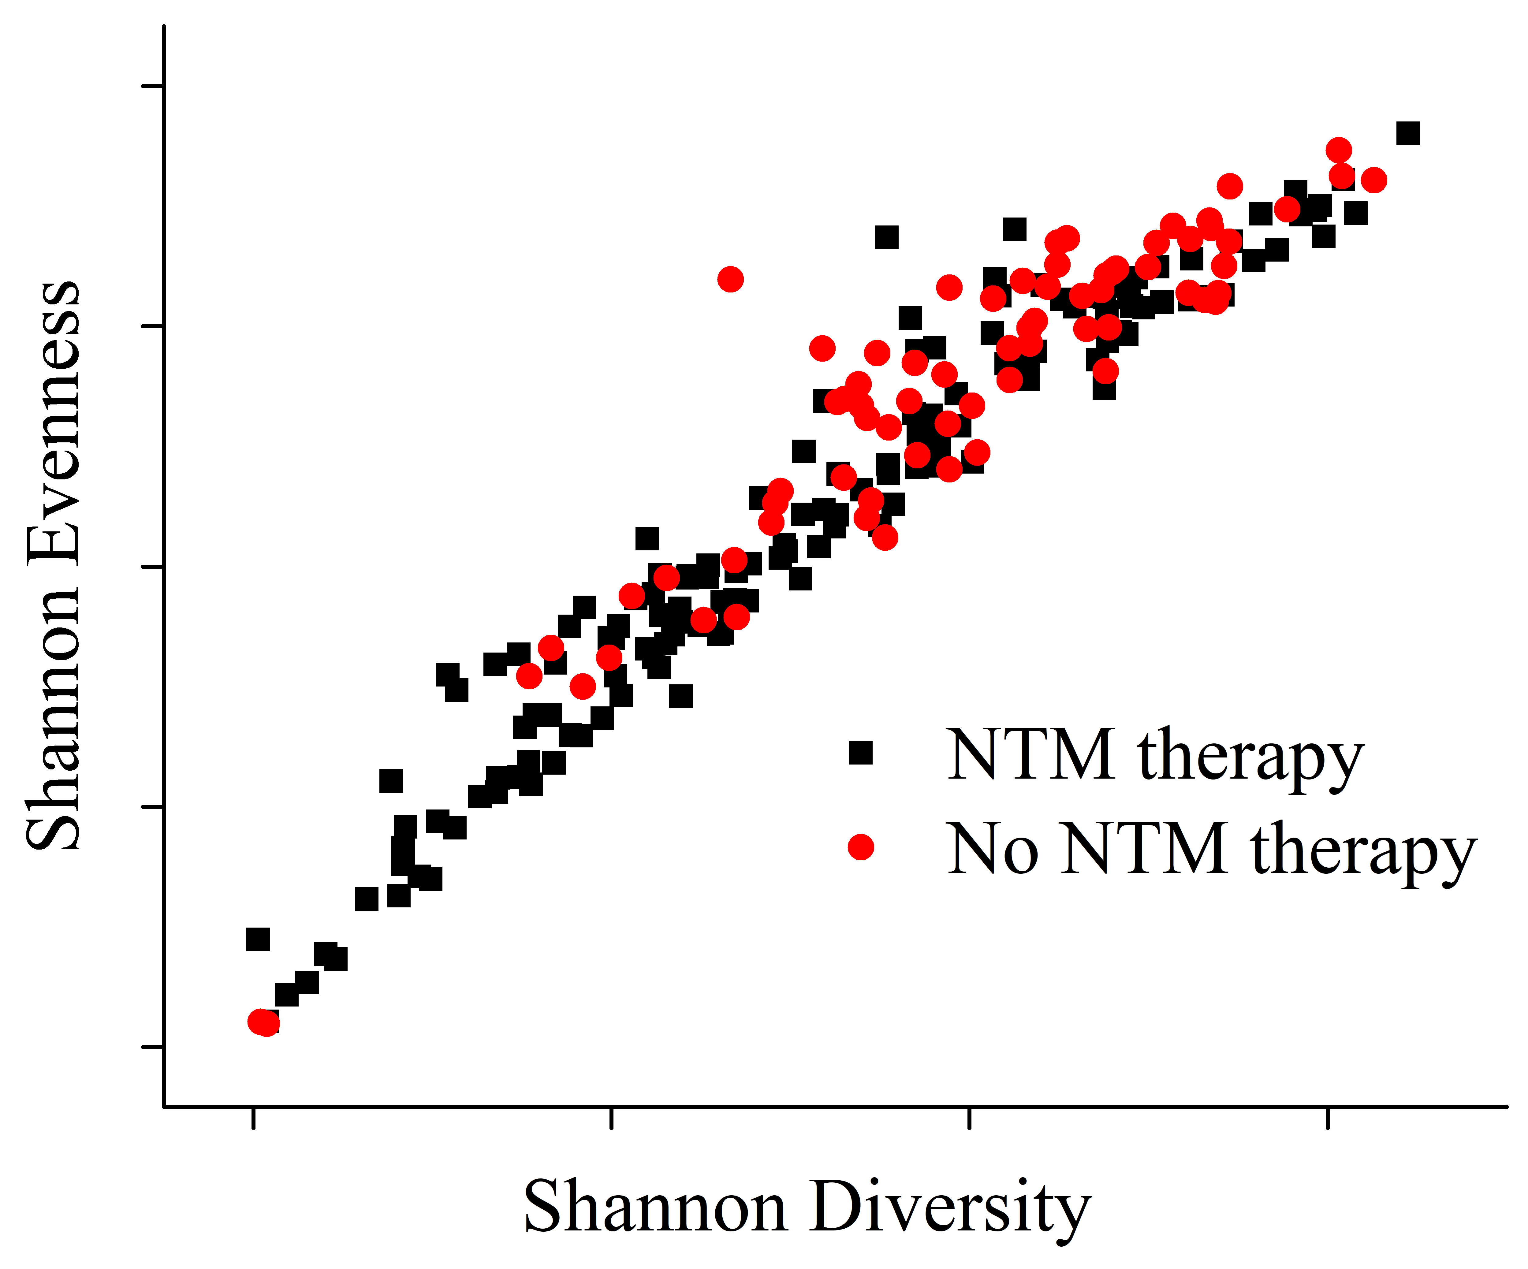
Methods explained: PCA

Slide 9
Data “boundaries” for NTM therapy
Principal
Component
Analysis
(PCA)

Slide 10
Methods
1
2
3
Identify least correlated features (linear combo.)
Identify best classifiers for NTM therapy
Evaluate cross-validation accuracy
PCA
SVM
Iterate

